Slide 1
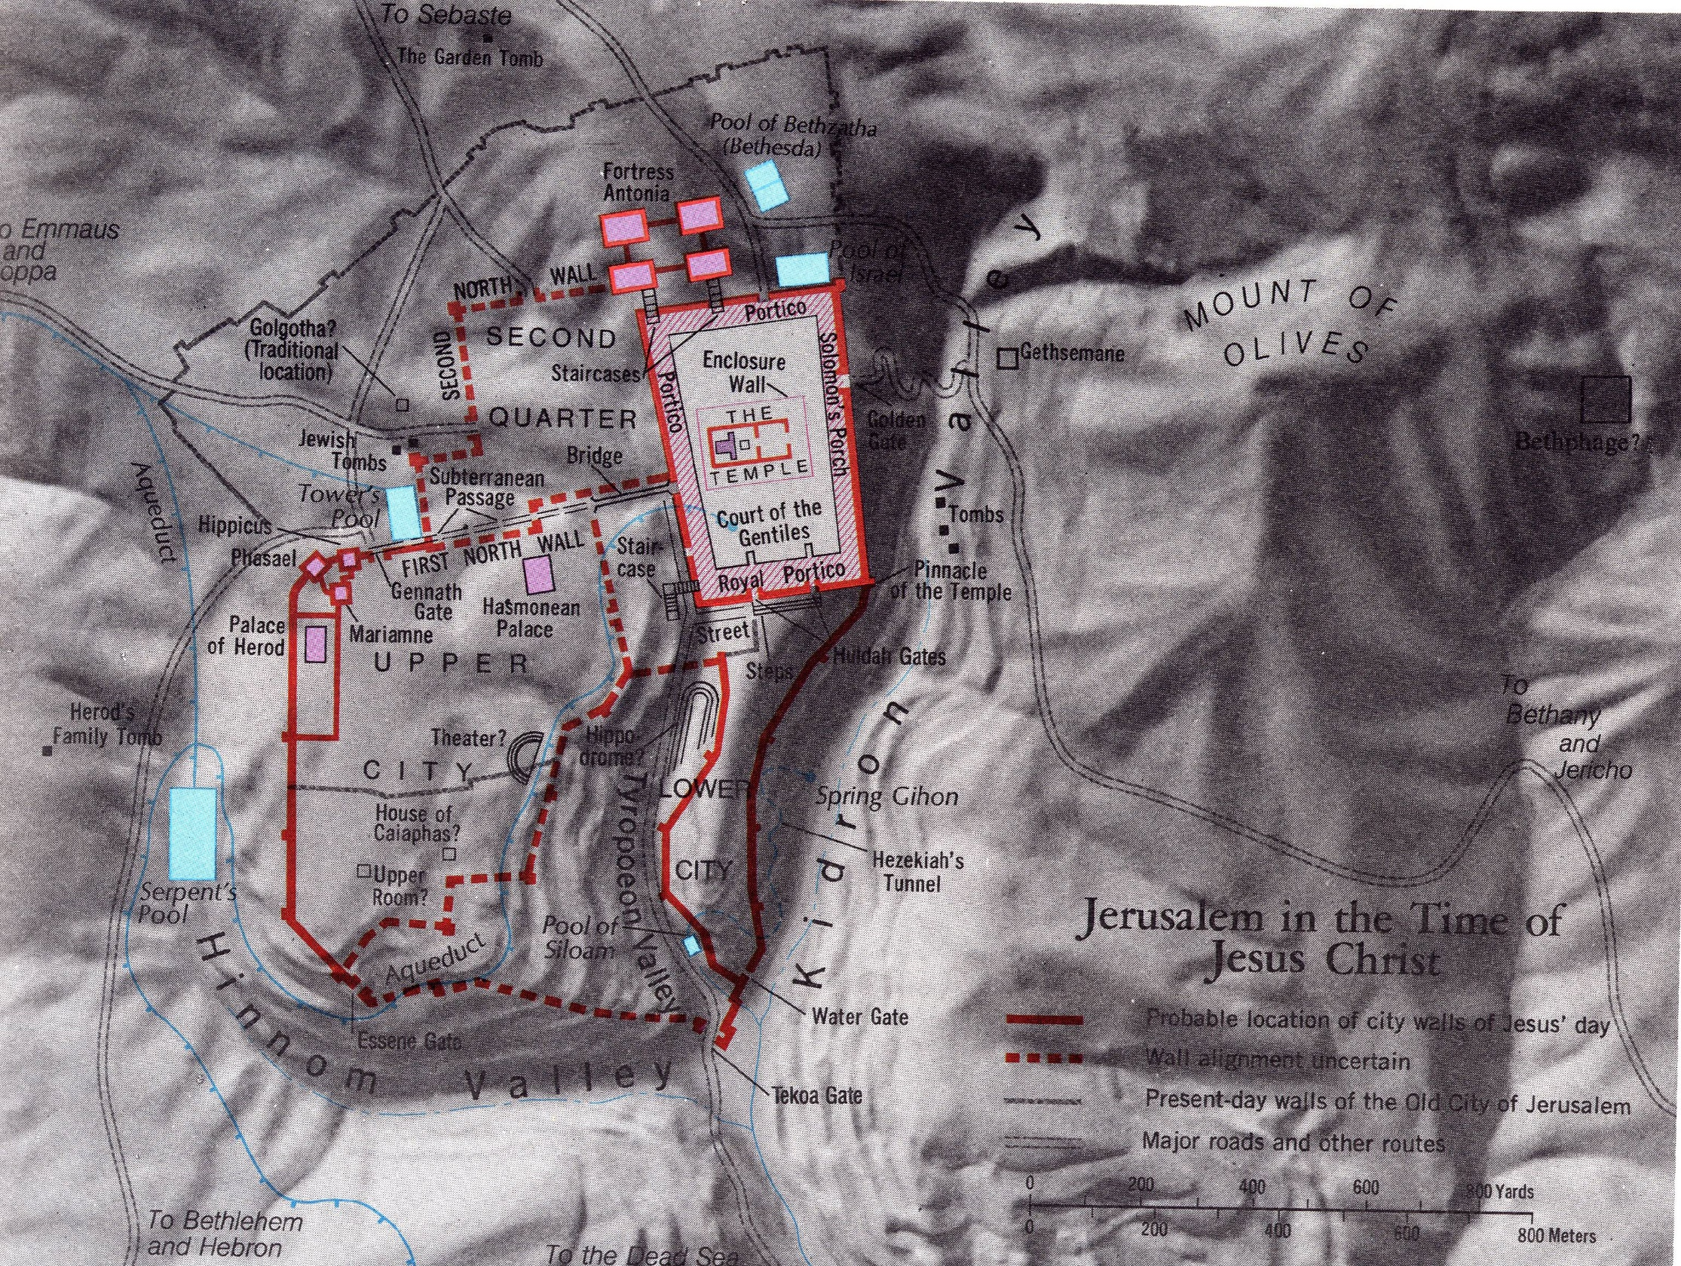
True Life Modelled in the First Church
Acts 2.42-47
Site of the first church
in the upper city of Jerusalem!

Slide 2
Acts 2.42-47 NET: ⁴²They were devoting themselves to the apostles' teaching and to fellowship, to the breaking of bread and to prayer. ⁴³Reverential awe came over everyone, and many wonders and miraculous signs came about by the apostles. ⁴⁴All who believed were together and held everything in common, ⁴⁵and they began selling their property and possessions and distributing the proceeds to everyone, as anyone had need. ⁴⁶Every day they continued to gather together by common consent in the temple courts, breaking bread from house to house, sharing their food with glad and humble hearts, ⁴⁷praising God and having the good will of all the people. And the Lord was adding to their number every day those who were being saved.

Slide 3
Love
from
God
Community with Believers
Influence with
Non-believers

Slide 4
Acts 2.42-47 NET: ⁴²They were devoting themselves to the apostles' teaching and to fellowship, to the breaking of bread and to prayer. ⁴³Reverential awe came over everyone, and many wonders and miraculous signs came about by the apostles. ⁴⁴All who believed were together and held everything in common, ⁴⁵and they began selling their property and possessions and distributing the proceeds to everyone, as anyone had need. ⁴⁶Every day they continued to gather together by common consent in the temple courts, breaking bread from house to house, sharing their food with glad and humble hearts, ⁴⁷praising God and having the good will of all the people. And the Lord was adding to their number every day those who were being saved.

Slide 5
Acts 2.42-47 NET: ⁴²They were devoting themselves to the apostles' teaching and to fellowship, to the breaking of bread and to prayer. ⁴³Reverential awe came over everyone, and many wonders and miraculous signs came about by the apostles. ⁴⁴All who believed were together and held everything in common, ⁴⁵and they began selling their property and possessions and distributing the proceeds to everyone, as anyone had need. ⁴⁶Every day they continued to gather together by common consent in the temple courts, breaking bread from house to house, sharing their food with glad and humble hearts, ⁴⁷praising God and having the good will of all the people. And the Lord was adding to their number every day those who were being saved.

Slide 6
Acts 2.42-47 NET: ⁴²They were devoting themselves to the apostles' teaching and to fellowship, to the breaking of bread and to prayer. ⁴³Reverential awe came over everyone, and many wonders and miraculous signs came about by the apostles. ⁴⁴All who believed were together and held everything in common, ⁴⁵and they began selling their property and possessions and distributing the proceeds to everyone, as anyone had need. ⁴⁶Every day they continued to gather together by common consent in the temple courts, breaking bread from house to house, sharing their food with glad and humble hearts, ⁴⁷praising God and having the good will of all the people. And the Lord was adding to their number every day those who were being saved.

Slide 7
True Life Is Relational!
Connecting to God
Bible teaching
prayer
awe, reverence for God
miraculous experiences
daily worship
thanks, praise for God
Connecting to each other
devoted to fellowship
prayed for/with each other
devoted to sharing meals
together daily, hospitable
shared their possessions
generous to the needy
Connecting to those outside the community
good relationships with unchurched
people added to their fellowship day by day.

Slide 8
True Life Is Purposeful!
Worship: devoted to prayer; reverential awe; miracles; daily worship; praise and thanks
Growth: devoted to biblical teaching
Fellowship: devoted to each other; prayed for/with each other; shared meals; hospitable; together daily
Service: shared; gave generously to the needy
Evangelism: good relationships with unchurched; people added to their fellowship day by day

Slide 9
True Life Modelled in the First Church
Acts 2.42-47
The first church
multiplied in Jerusalem!

